Slide 1


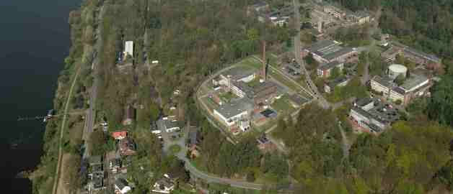
m-dml.org
Deep Differentiable Emulators
David Greenberg Model-driven Machine Learning Group Helmholtz Centre Hereon
Deep Learning and Optimization
IMT Atlantique
November 22, 2022
mNov. 22, 2022

Slide 2
Outline
1 Deep Differentiable Emulators for Inverse Problems in the Geosciences
2 Hybrid Emulators
3 ML Models as Earth System Model Components

Slide 3
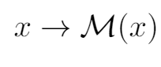
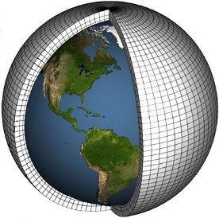
Simulators as State space models
System state
Physical variables (pressure, temperature, moisture, …)
Snapshot for one time point
x₀
x₁
x₂
State update function
Fluid dynamics
Local physical processes (radiation, turbulence, phase changes, …)
Advection of tracers (droplets, aerosols, etc.)

Slide 4
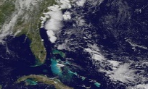
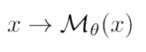
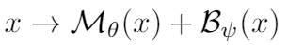

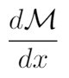
3 optimization tasks in the geosciences
x₀
Prediction
θ
ψ
1 Data assimilation: choose x₀ so predictions match observations
2 Model tuning: choose θ so predictions match observations
3 Learning corrective terms: choose ψ so predictions match observations
Because: unknown physics, sub-grid-scale processes
For all 3 problems, we need in order to optimize our predictions over x₀, θ or ψ.
But these derivatives are not available for most simulators!
Notes:
Suppose we have a simulator describing a physical system, and noisy and incomplete observations of this system. Suppose also that given a system state, we can make a prediction of which observations are likely to be obtained.
Won’t show task 3
For all 3 problems, to address the task effectively using gradient based optimization techniques we need to differentiate through the simulator’s update function
These gradients are usually not available, especially for the majority of Earth science simulators written in Fortran

Slide 5
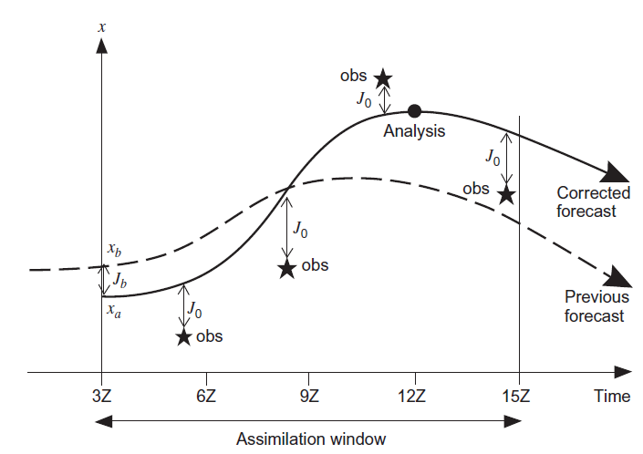
Data Assimilation
Goal: find a sequence of system states that matches both model and data
Holton, 2012

Slide 6
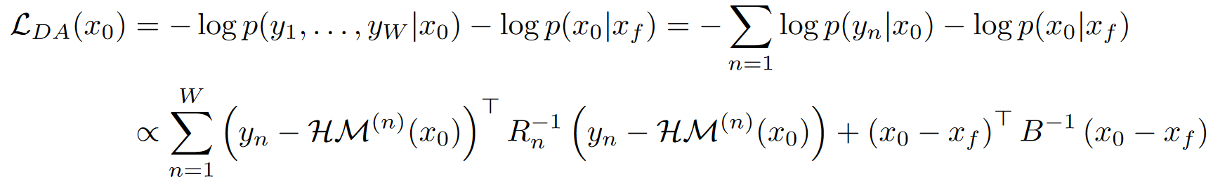
Strong Constraint 4DVar
How can we formalize our desire to match both model and data?
Assumption 1: initial state x₀ has a Gaussian prior with mean x_{f} and covariance B.
Assumption 2: for state x, observations y are Gaussian with mean H(x), covariance R
Now let’s carry out maximum a posteriori estimation likelihood: we find the initial state x₀ with the highest the posterior probability given observations and prior assumptions. This is equivalent to minimizing an objective function:

Slide 7
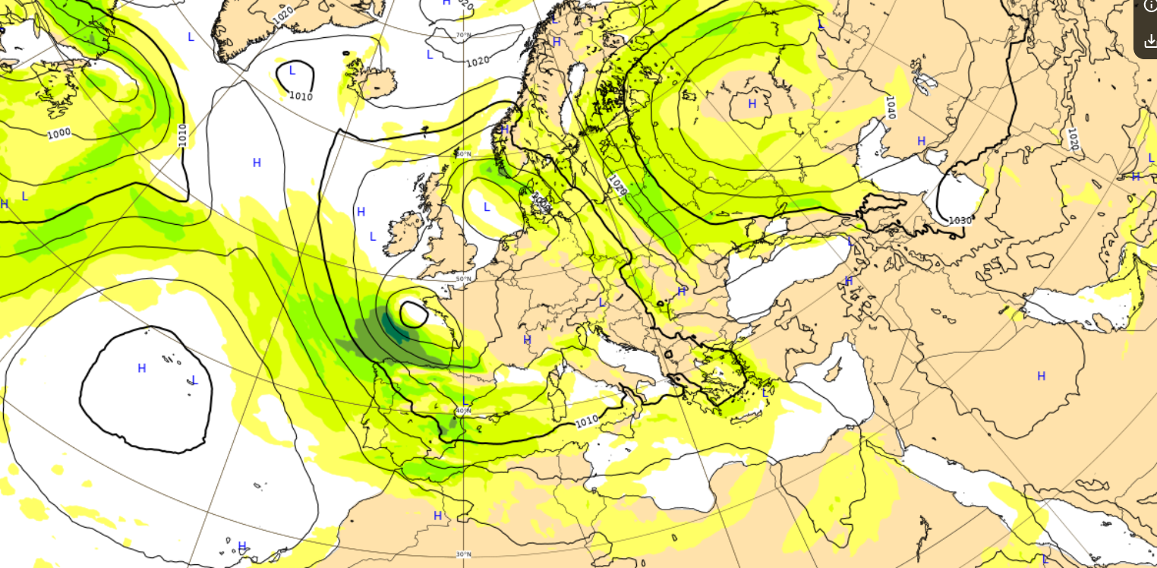
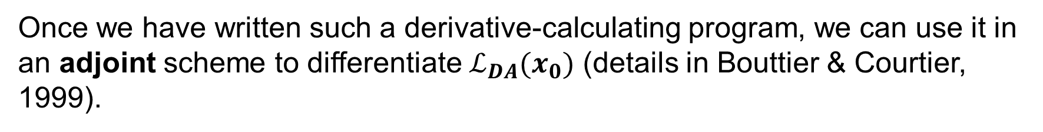
How to minimize $ℒ_{DA}(x_{0})$?
Strategy A: hand-written simulator gradient routines
We can minimize $ℒ_{DA}(x_{0})$ by optimization if we can calculate its derivatives with respect to x₀.
To do this we require a computer program that calculates $dℳ(x)/dx$ for any x, where $x_{n+1}=ℳ(x_{n})$.
Once we have written such a derivative-calculating program, we can use it in an adjoint scheme to differentiate $ℒ_{DA}(x_{0})$ (details in Bouttier & Courtier, 1999).
Example: ECMWF Integrated Forecast System
Graph shows part of x corresponding to see mean sea level pressure and wind speed at 850 hPa at 12:00 on 07.12.2020.
y consists of ~25 Million observations in a 12 hour window

Slide 8
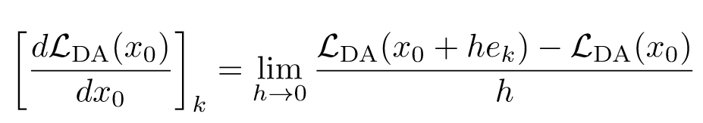
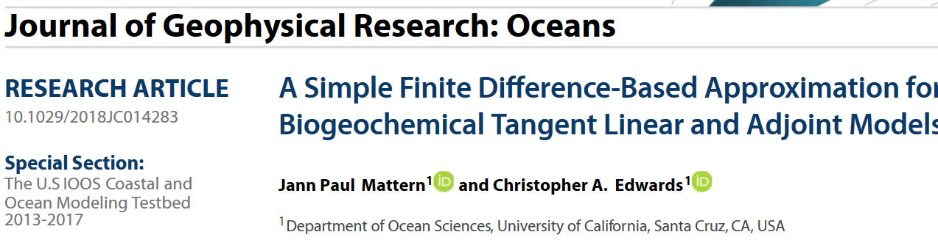

How to minimize $ℒ_{DA}(x_{0})$?
Strategy B: finite differences
What if we don’t have a hand-written gradient routine for $ℳ$?
We want to calculate the vector of derivatives $\frac{dℒ_{DA}(x_{0})}{dx_{0}}$. By definition this is simply
where e_{k} is the k-th coordinate unit vector.
We can approximate this limit using a small, nonzero value for h. While simple, this method is easy to implement and sometimes used effectively with low-D system states!

Slide 9
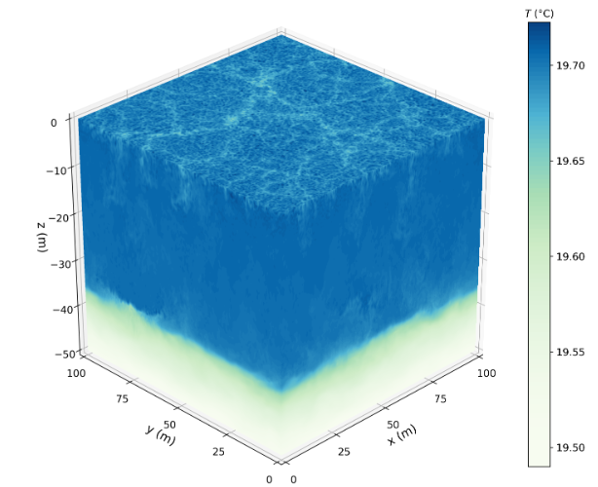
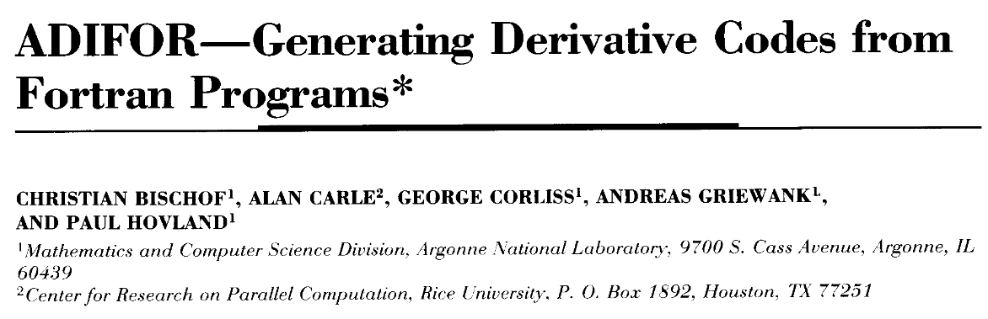
How to minimize $ℒ_{DA}(x_{0})$?
Strategy C: automatic differentiation
Instead of writing a computer program to calculate dM(x) / dx, we can calculate this derivative automatically.
For simulators implemented in modern machine learning frameworks (PyTorch, Julia, JAX, etc.), derivatives can be calculated for all implemented functions automatically with no extra programming.
Oceanic boundary layer turbulence forced by surface cooling
Oceananigans.jl in Julia
Ramadhan et al., 2020
Added bonus: GPU support & frequent updates!
What about the vast majority of Earth science simulators, which are programmed in environments (e.g. Fortran) that don’t provide autodiff?
Some tools for automatically writing differentiation routines do exist, but are mainly based on inefficient static code analysis, and rarely used.

Slide 10
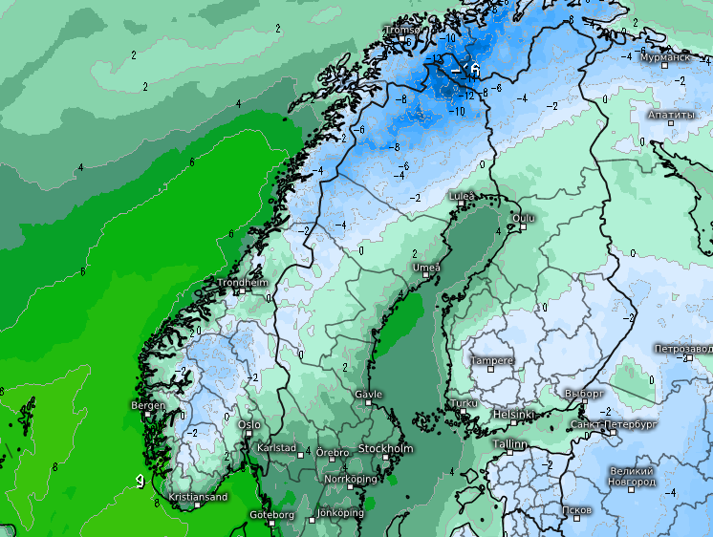
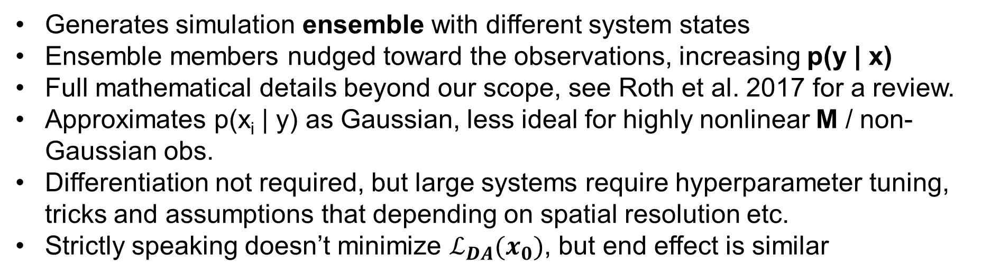
How to minimize $ℒ_{DA}(x_{0})$?
Strategy D: Ensemble Kalman Filter (EnKF)
Generates simulation ensemble with different system states
Ensemble members nudged toward the observations, increasing p(y | x)
Full mathematical details beyond our scope, see Roth et al. 2017 for a review.
Approximates p(x_{i} | y) as Gaussian, less ideal for highly nonlinear M / non-Gaussian obs.
Differentiation not required, but large systems require hyperparameter tuning, tricks and assumptions that depending on spatial resolution etc.
Strictly speaking doesn’t minimize $ℒ_{DA}(x_{0})$, but end effect is similar
Temperature prediction over northern Europe, 12:00 on 07.12.20
ICON, run by the German Weather Service using EnKF

Slide 11

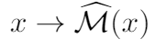
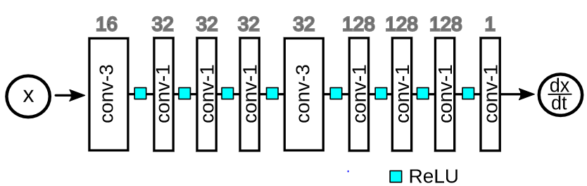
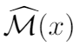
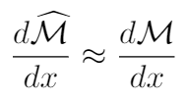

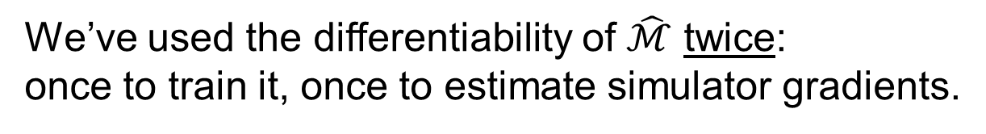
Differentiating Simulators with ML
How can we obtain derivatives of the state update function ?
1. Generate simulations
2. Train a neural network to emulate
the state update function
3. Differentiate the neural network’s
outputs w.r.t its inputs to obtain:
Marcel
Nonnenmacher
We’ve used the differentiability of $\hat{ℳ}$ twice:
once to train it, once to estimate simulator gradients.
Nonnenmacher & Greenberg, 2020, JAMES
Notes:
Marcel

Slide 12
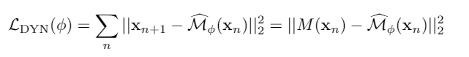
Objective Function for Emulator Training
Emulator state
update function
Objective function
Next system state
Neural network parameters
Simulator state update function
Time index

Slide 13
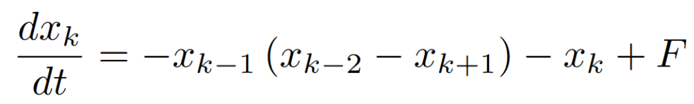

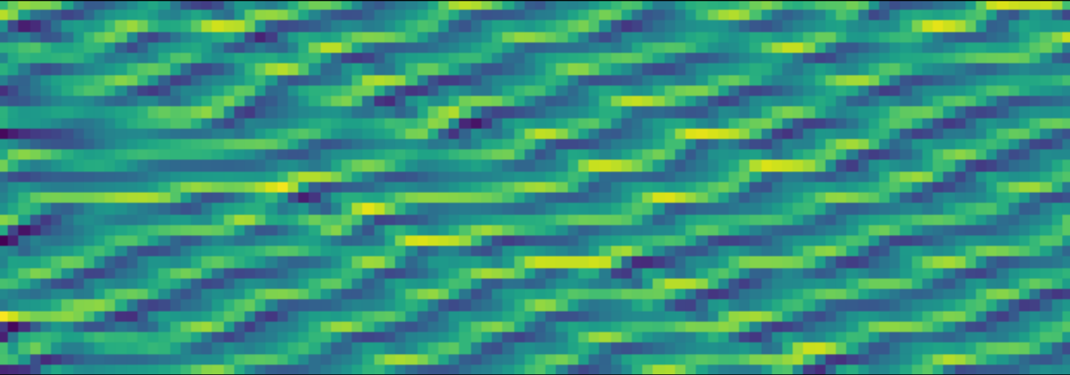
Model System: Lorenz `96
Lorenz, 1996
40 coupled nonlinear differential equations
Chaotic dynamics (Lyapunov time 1.67 for F = 8)
Time
Notes:
Toy model but we’ll see more complex stuff at the end

Slide 14
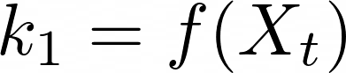
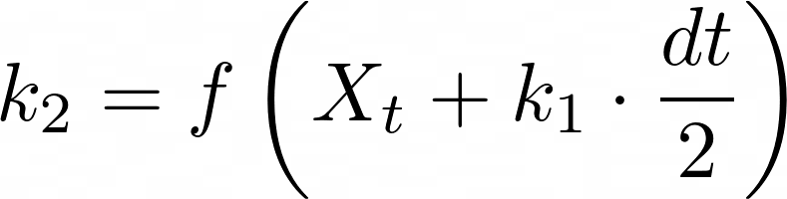
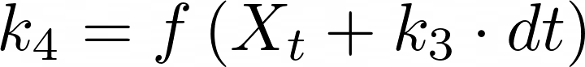
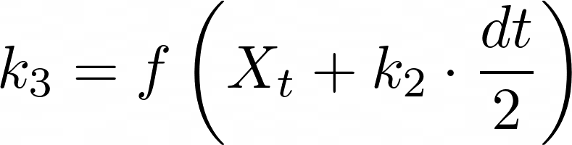
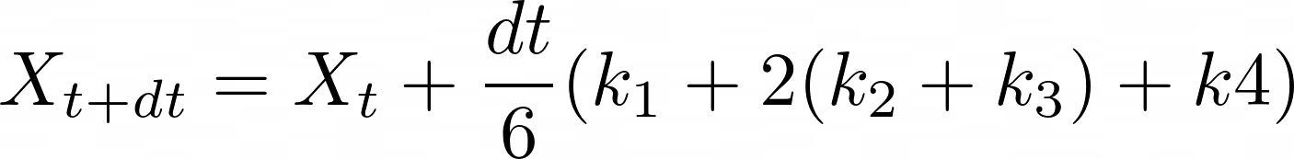
Runge-Kutta Integration
dX
dt/2
dX
dX
dX
X
k
k
dt/2
k
dt
k
t
dt
1
dt
2
dt
3
dt
4
2
X
dt/6
t+dt

Slide 15

Choosing a Neural Network Architecture for our Emulator
x
How should we design the network architecture of the emulator?
Decisions to be made:
Number of layers
Number of units in each layer
Type of layers (convolutional, recurrent, …)
Activation function (Relu, tanh, Elu …)
For L96:
We use 1D convolutional layers to exploit spatial structure and spatial invariance
We use periodic convolutions to match information flow in the state space
We use a limited number of layers with size 3 kernels, and the rest operate on each spatial location independently to preserve causal structure for any network depth
We could also have tried to match the mathematical operations in the simulator (e.g. bilinear layers)
Overall: we can use partial knowledge in architecture design

Slide 16
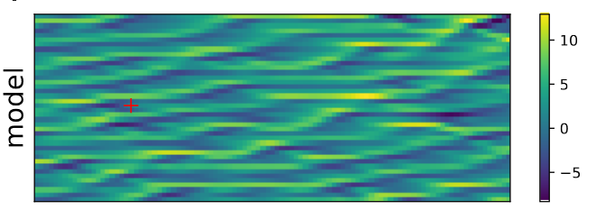
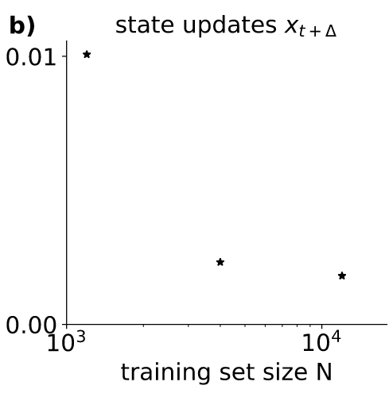
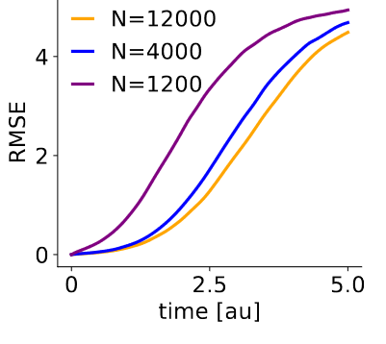
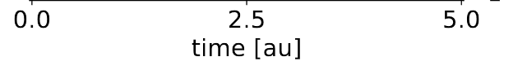
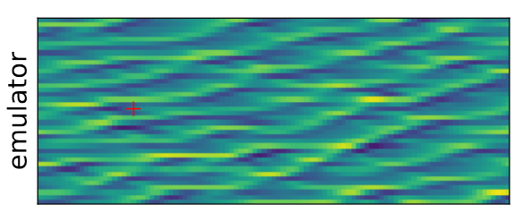
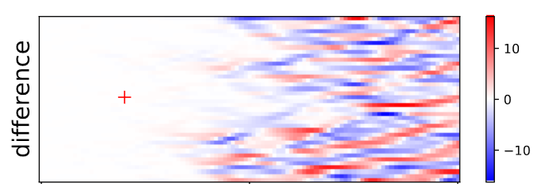
Accuracy of emulators trained on Lorenz `96

Slide 17
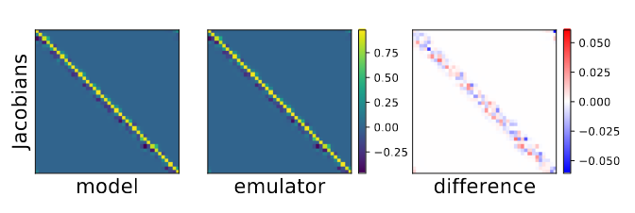
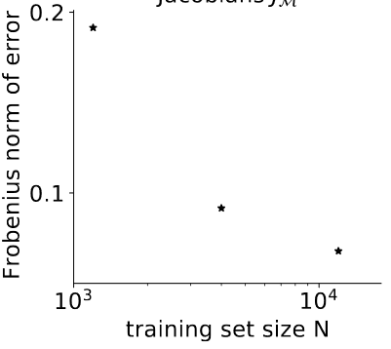
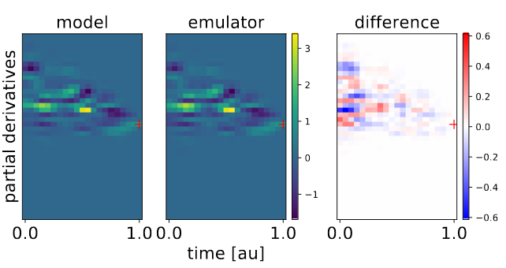
How Accurate are Estimated Input Derivatives?
…for a single time step?
…for longer simulations?

Slide 18


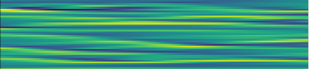
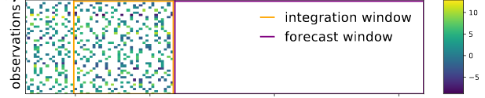
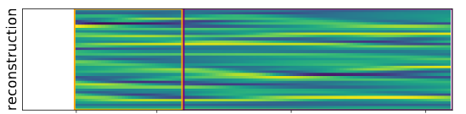
Data Assimilation for L96
x₀
Ground
truth
Noisy & incomplete
observations
Emulator
reconstruction

Slide 19
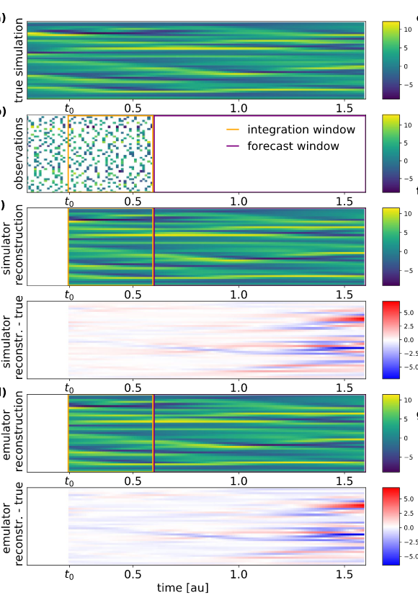
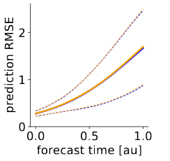
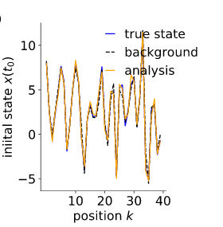
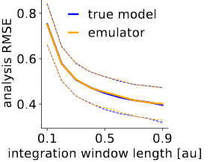
Data Assimiliation with True vs. Estimated Simulator Derivatives

Slide 20
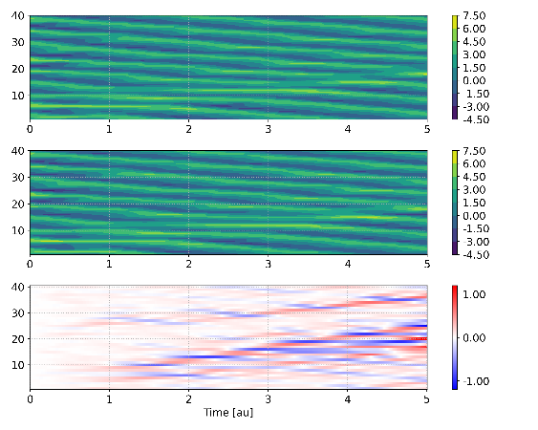
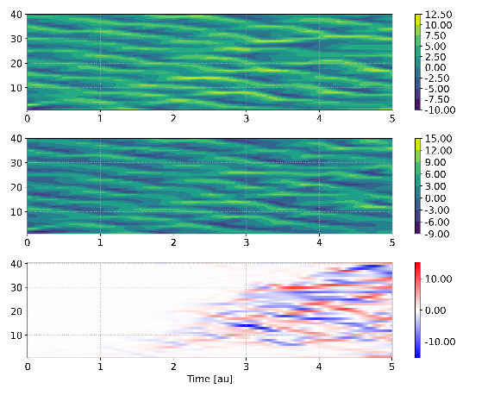
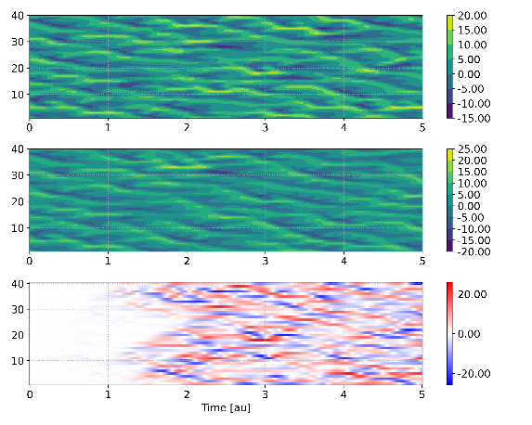

Application 2: Model Tuning
θ
F = 4
F = 8
F = 14
Simulator
Conditional emulator
Vadim
Zinchenko
θ
Notes:
Task: estimate F from noisy and incomplete observations of the system state

Slide 21
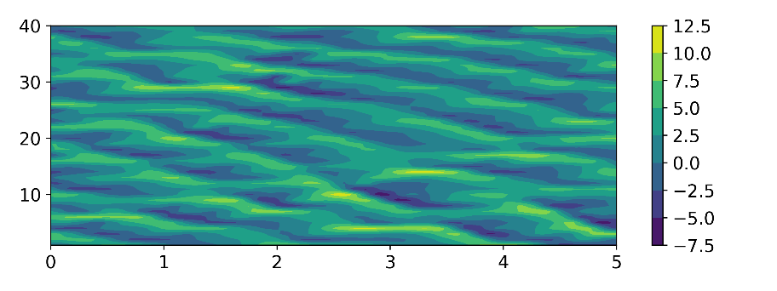




Application 2: Model Tuning
Simulator
F = 7.1
Task: estimate parameter from noisy, incomplete observations
Strategy: estimate simulator parameters by optimizing over the input to a conditional emulator
Conditional emulator
F = 7.0 (optimized)
Conditional emulator
F = 5.0 (too low)
Conditional emulator
F = 9.0 (too high)

Slide 22


Application 3: Learning To Parameterize Sub-grid-scale Processes
ψ
2-level L96 model
Task: learn a correction to 1-level L96 so that it behaves like the 2-level model
Animation: Stephan Rasp

Slide 23


Application 3: Learning To Parameterize Sub-grid-scale Processes
Fine-scale model
Coarse-scale model with corrective term

Slide 24
Outlook and Future Challenges
Differentiable emulators can provide in order to optimize our predictions over x₀, θ or ψ.
But:
physical knowledge is discarded
too many potential interactions, especially for fluid dynamical integration steps.
Difficult to scale to large and complex systems

Slide 25


Training Emulators with Local Structure on Partial System States

Slide 26





Forward pass compute for Earth science >> ML
Example: ICON model for numerical weather prediction (DWD, MPI-M)
Mistral, DKRZ (>10⁵ processors, 3.6 PetaFLOPS)
2949120
grid cells
90
z-levels
10+
variables / location
Simulation code: FORTRAN, often > 10⁵ lines
Total values / time point: 2.6 billion
Or with a time step of 120 seconds,
Total values / simulated day: 1.9 trillion
Stevens et al., 2019, Reinert et al., 2021
Notes:
Models are large, lots of work has gone into them, specialized hardware, not easy to reimplement from scratch!

Slide 27
Outline
1 Deep Differentiable Emulators for Inverse Problems in the Geosciences
2 Hybrid Emulators
3 ML Models as Earth System Model Components

Slide 28






Weather Prediction by Numerical Process (Richardson, 1922)

Slide 29









Complementary Advantages of ML and Simulation
Machine Learning
Numerical Simulation
Performant, efficient
Non-interpretable, poor generalization
Interpretable, physical, good generalization
Hard to fit data, difficult inverse problems
X
X
Architectures
Algorithms
Ocean
Hydrology
Atmosphere
Impacts
Chemistry
Ecosystems
Hybrid Methods
29
Notes:
30s
To analyze, simulate and forecast the Earth system we can use data-centric machine learning or numerical simulations incorporating scientific knowledge.
Both go back over a century and remain relevant today
They have complementary strengths and weakness:
ML is efficient for data fitting, but ignores what we know as scientists
Simulation incorporates our knowledge, but lacks the flexibility and efficiency in data fitting
Our research seeks to combine the best aspects of ML and numerical simulation, achieving better cost-accuracy tradeoffs and improve our understanding of the Earth system

Slide 30




Shallow Water Equations – Semiimplicit Scheme

Slide 31

Can we learn 2D SWE with standard convnets?
t = 20
t = 100
Shallow water equations
Emulator
(convnet)
Difference

Slide 32








Spatial dependency of updates
x_{n}
x_{n+1}
PDE
φ
Discretization
λ
Explicit Euler Integration
2nd order explicit
(Semi)implicit
CNNs scale poorly with size of x
Notes:
We thought about why the emulators failed to learn for this model, and this got us thinking about how the simulator updates the system state
In particular, how does a single location of the new system state depend on locations in the old state?

Slide 33






Putting a Linear Solver into a Neural network
input
x
output
y
Fully connected layer
Convolutional layer
m x 1
m x m
m x 1
k x k
k << m
m x m
k²m elements ≠ 0
Implicit Linear Layer
m x m
k²m elements ≠ 0
m x 1
m x 1
Nonnenmacher & Greenberg, 2021

Slide 34


Linear Implicit Layers: Forward Pass
Forward pass
Goal: compute $y$ from $x$, $θ$
$$A(x)=\sum_{k∈K⊂ℤ}{A_{k}}$$
$$A_{k}=\sum_{i}{e_{i}e_{i+k}^{T}g_{i}^{k}\left(x, θ_{i}\right)}$$
$$b\left(x\right)=g_{b}(x, θ_{b})$$
We solve $Ay=b$ using an iterative solver
$$y_{m}→y$$
e.g. conjugate gradient or red-black Gauss-Seidel.
This doesn’t require inverting or factorizing $A$, only calculating $Az=\sum_{k}{A_{k}z={{diag(g}^{k})⋅S}^{−k}z}$, where $S^{k}$shifts the vector elements forward by $k$ positions
This allows us to solve the system even for very large $A$, such as when $x$ and $y$ are images.
Banded matrix:
$A_{ij}=0$ when $\left|i−j\right|>B$
A is sparse, but its inverse is not!

Slide 35

Linear Implicit Layers: Backward Pass
Backward pass
Goal: compute $\frac{dℒ}{dx}$, $\frac{dℒ}{dθ}$ from $x, y, θ,\frac{dℒ}{dy}$
Implicit differentiation w.r.t $b$ gives
$$\frac{d}{db}\left(Ay\right)=I$$
$$\frac{dy}{db}=A^{−1}$$
$$\frac{dℒ}{db}=\frac{dℒ}{dy}\frac{dy}{db}={\frac{dℒ}{dy}A}^{−1}$$
$$A^{T}{\frac{dℒ}{db}}^{T}={\frac{dℒ}{dy}}^{T}$$
so we have to solve the transposed (adjoint) system in the backward pass.
A similar argument gives
$$\frac{dℒ}{dA}=−\frac{dℒ}{db}vec{\left(z\right)}^{T}$$
So we only need one solve.
Banded matrix:
$A_{ij}=0$ when $\left|i−j\right|>B$
A is sparse, but its inverse is not!

Slide 36


LILs: How to Ensure the Learned System can be Solved
We want to ensure
Invertibility of $A$
Convergence of the iterative solver
But $A,b$are data-dependent!
Solution: built-in diagonal dominance
Main diagonal defined as row-wise sum of absolute values of other entries, plus an exponential function
Ensures convergence of Gauss-Seidel, and many other iterative solvers

Slide 37

LILs Are Accurate and Stable for Larger Time Steps

Slide 38





Exploiting Known PDE Symmetries
Specialized Convolutional Layers (Cohen & Welling, 2016)
2D Shallow water equations
For our neural network $f:x→y$
We want the equivariance relation
$${f(𝒯}_{g}(x))=𝒯_{g}(f(x))$$
to hold for any input $x$ and transformation $g$ in a symmetry group.
Example: for fully convolutional nets, translating the input translates that output.
But what about other symmetries?
Yunfei
Huang

Slide 39




Learn Process Rates/Fluxes, not Tendencies, to Enforce Conservation Laws
Notes:
30s
To analyze, simulate and forecast the Earth system we can use data-centric machine learning or numerical simulations incorporating scientific knowledge.
Both go back over a century and remain relevant today
They have complementary strengths and weakness:
ML is efficient for data fitting, but ignores what we know as scientists
Simulation incorporates our knowledge, but lacks the flexibility and efficiency in data fitting
Our research seeks to combine the best aspects of ML and numerical simulation, achieving better cost-accuracy tradeoffs and improve our understanding of the Earth system

Slide 40






Scaling up further?
Lorenz ’96
640 x 1
Quasigeostrophic Model
64 x 64 x 2
Shallow Water Equations
100 x 100 x 3
ICON-A
2949120 x 90 x 10
Lorenz ’96
40 x 1
System State Size
New technical problems: data flow, specialized distributed computations

Slide 41
Outline
1 Deep Differentiable Emulators for Inverse Problems in the Geosciences
2 Hybrid Emulators
3 ML Models as Earth System Model Components

Slide 42
ML Models for Specific Processes in Earth System Simulations
Earth system simulation
Known processes
Efficient computation
Emulator to provide gradients
Costly computation
Emulator to improve
cost / accuracy tradeoff
Unknown processes
Learn from observations
Notes:
2m
One way of building hybrid methods is to put ML-based components inside of numerical simulations
Suppose we have a complex simulation of the Earth system, such as a climate or weather model. How can we improve it using ML?
clearly, for the parts of our physical simulation where we have good understanding and high numerical efficiency, we don’t’ want to reinvent the wheel with ML. these components should stay as they are!
For processes that we can simulate accurately, but where these simulations are too computationally costly for large scale simulation experiments or operational climate/weather services, we want to train fast emulators using simulation data.
Cloud microphysics, working with German weather service and MPI-M
Important for climate and weather, radiation balance
Most accurate simulations use droplets, but too slow for weather and climate models
Combines ML with meteorology and dynamical systems, see poster and flash talk by our PhD student Shivani Sharma for more info!
Atmos chem, Helmholtz AI project with KIT
Important for climate and air quality prediction
Existing schemes accurate but slow implicit for stiff ODEs
This limits us to gross simplifications of atmospheric chemistry in practice, especially for long running climate sims
But there are also some processes where the limiting factor isn’t computation but understanding. Here we want to learn a process model directly from observations.
We’re doing this to build a model of mass and nutrient fluxes in ocean ecosystems, in a Horizion Europe project
Here we want to keep the known fluid dynamics while using ML to describe unknown biological proceses

Slide 43





Parameterization Learning with ML: State of the Art
Superparameterized convection/radiation
Rasp et al., 2018
Turbuluent heat flux
Ramadhan et al., 2019
Radiation
Pal et al., 2019
Moist Convection
Yuval et al., 2021
Nonorographic
gravity wave drag
Chantry et al., 2021
Common theme: good performance on 1-step updates doesn’t guarantee long term accuracy or stability!

Slide 44
The “Coupling Problem”
store outputs
Parameterization
to be learned
Dynamics &
other physics
store inputs
Train ML parameterization offline
to map inputs onto outputs
We can couple the trained ML parameterization to the full model…
Automatic
differentiation
ML
parameterization
Dynamics &
other physics
Fortran or C++,
derivatives
unavailable
..but we can`t couple during training!

Slide 45


Single column & box models
Key idea: local data, no horizontal motion, fixed forcing / boundary conditions
By avoiding two-way coupling, we can easily incorporate multiple time steps during training
one-way
forcing
self-iteration
Dynamics &
other physics
Parameterization
Derivatives not needed!
Automatic differentiation
Self-iteration during training increases accuracy and stability!
Convection / radiation
Brenowitz & Bretherton, 2018
Warm rain microphysics
Seifert & Rasp, 2020

Slide 46







Learning Bulk-moment Microphysics Consistent with Droplet Simulations
Goal: realistic cloud simulations for accurate climate and weather prediction
Challenge: droplet-based simulations are accurate, but inefficient
Solution: ML model trained to predict statistics of droplet size
Hierarchy of spatial scales
Accurate prediction of rain water mass
Accurate
cloud → rain transition
Prediction
Rain mass
True rain mass
Time (min)
Shivani
Sharma
Next steps: coupling to ICON, spatial structure, new hydrometeors, aerosols
Notes:
To analyze, simulate and forecast the Earth system we can use data-centric algorithms or simulations incorporating domain knowledge.
Both of these approaches go back over a century and remain highly relevant today
They have complementary strengths and weakness:
ML is efficient for data fitting, but ignores what we know as scientists
Simulation incorporates our knowledge, but lacks the flexibility and efficiency in data fitting
Our research combines the best aspects of ML and numerical simulation
In this way we aim to transcend existing tradeoff between computational accuracy and cost, and improve our understanding of the Earth system
This idea has spawned a wide variety of promising and powerful new methods

Slide 47







ML-accelerated Time Stepping for Stiff Chemical Systems
Chemical
kinetics
Radiation
Temperature
Fluid Dynamics
$$d\left[HNO_{3}\right]/dt$$
Keller & Evans, 2019
Rosenbrock Solver (s-stages)
Kelp et al., 2022
s linear systems to be solved at each time step

Slide 48
Summary
Emulators can provide missing derivatives for solving inverse problems
Accuracy can be improved by physical or symmetry constraints, or by mimicing numerical solver components
For large Earth system simulations, individual processes can be emulated
One-way coupling during training can (sometimes) improve accuracy in fully coupled mode
We’re still lacking many important tools and components for building and exploiting fully differentiable simulations

